Slide 1

IzbaAI
AI Realty Estate Agent

Slide 2



Problem
Painful and time-consuming search for suitable real estate objects for purchase
Multiple sources of data / scattered information across several platforms
Current solutions provide limited search criteria forcing users to compare listings manually
Existing solutions:

Slide 3
Solution
IzbaAi is an AI tool that helps to aggregate data from multiple sources and provides extra context based on user criteria.
Key Features
Web agent with search capabilities using current market Rightmove listings.
Featuring detailed data for property and surrounding area (commute time to specific address, best cafes around the property, etc.).
Ability to provide historical pricing details.

Slide 4

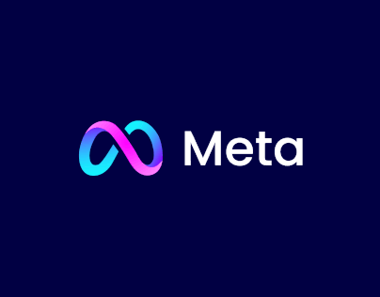
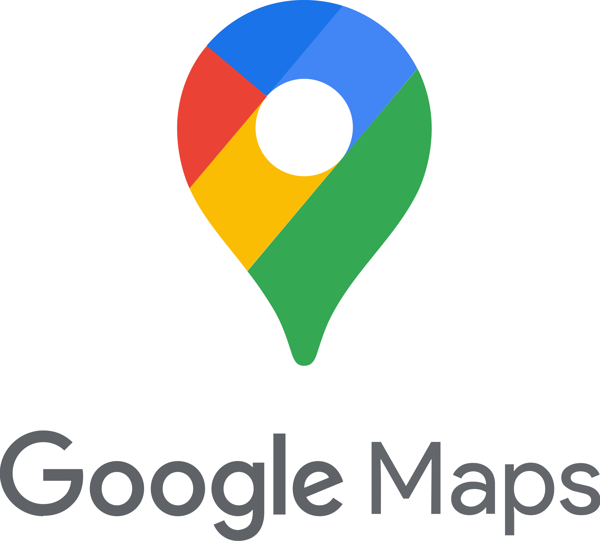


Tech Stack

Slide 5
Vision

Slide 6
Demo

Slide 7
Demo

Slide 8
Imagine you can afford buying a property in London.
Your feelings:

Slide 9

But searching for real estate to buy actually feels like

Slide 10
There’s something to heal your pain

Slide 11
IzbaAI – your personal AI Realty Estate Agent

Slide 12
Key features
Web based Smart AI search
Aggregated info from multiple sources
Personalized area details

Slide 13
Demo

